Slide 1
Operation MP Watch
    by: Polltergeist

Slide 2
What constituency am I in?
Boundaries change all the time.
Which GRC am I in?
Who's my MP or MPs?
But I will have to vote...

Slide 3
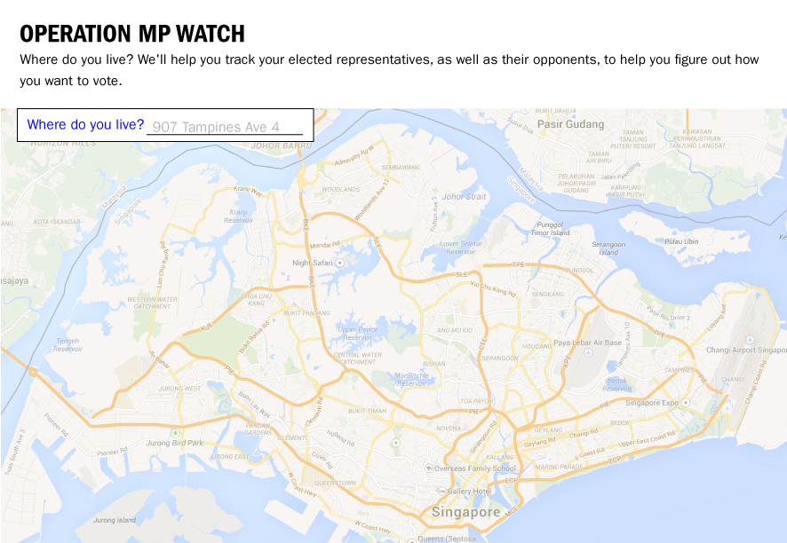
Operation MP Watch

Slide 4
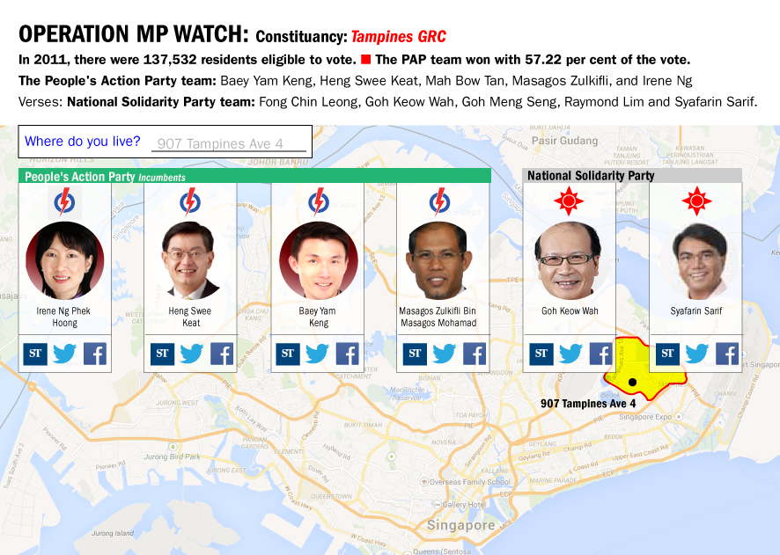
Operation MP Watch

Slide 5
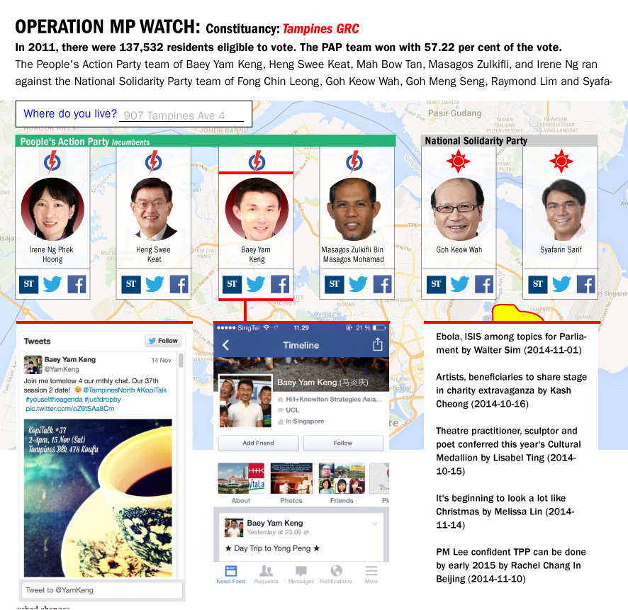
Operation MP Watch

Slide 6
Civic service
Voting is compulsory for all Singapore citizens above 21
2.41 million registered voters
87 per cent of Singapore households have Internet access at home
Even if just 20 per cent of registered voters will use it, that's still >400,000 potential users

Slide 7
Here be ads
“Hungry after doing your civic duty? Try the Best Ramen Ever at Neighbourhood Mall”
“Cooling Off Day not enough break for you? Fly to Bali, Phuket or Penang on TigerStarAirways from just $8”
More seriously - partnerships with media outlets

Slide 8
Future (aka Stuff We Didn't Have Time To Add)
Searchable parliamentary reports
Crowdsourced information: MPs' and candidates' directorships, registered businesses, CVs, LinkedIn.
Other social media (political rallies on YouTube)
Same techniques can be used for other cities/ countries

